Slide 1
Overview of gradient descent and its variants
Linlin Zhao

Slide 2
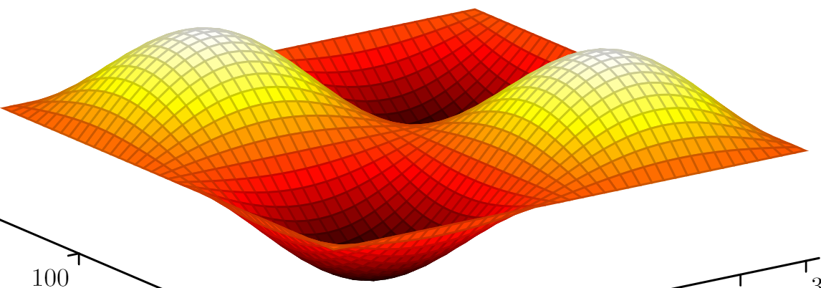
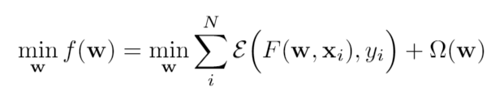
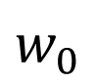
Optimization
$$w_{0}$$
Notes:
Because of the scale and dimension of systems, analytical optimization is often infeasible. We need to use iterative methods.

Slide 3
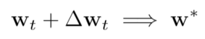
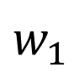
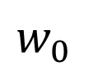
Optimization-iterative methods
$$w_{0}$$
$$w_{1}$$
Notes:
Because of the scale and dimension of systems, analytical optimization is often infeasible. We need to use iterative methods.

Slide 4
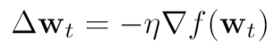
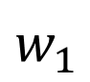
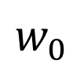
Steepest gradient descent
$$w_{0}$$
$$w_{1}$$
Notes:
Because of the scale and dimension of systems, analytical optimization is often infeasible. We need to use iterative methods.

Slide 5
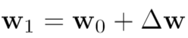
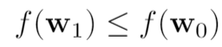
Mathematical understanding of gradient descent
Goal:
such that

Slide 6
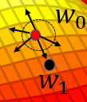
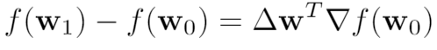
Mathematical understanding of gradient descent
Goal:
such that
First order approximation
Notes:
When the circle is small enough, we can make the first order approximation.

Slide 7
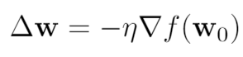
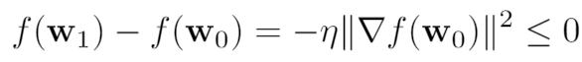
Mathematical understanding of gradient descent
Goal:
such that
Notes:
All the variants of SGD is twisting the eta and gradient. On the saddle point, the gradient is close to zero, making the training hard to escape. The eta has to be small enough such that the approximate is good.

Slide 8
Mathematical understanding of gradient descent
Goal:
such that
Notes:
All the variants of SGD is twisting the eta and gradient. On the saddle point, the gradient is close to zero, making the training hard to escape. The eta has to be small enough such that the approximate is good.

Slide 9
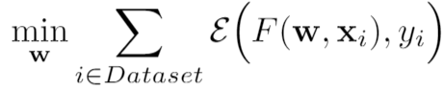
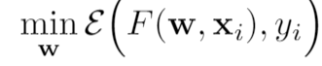
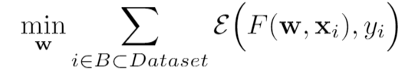
Gradient descent
Batch gradient descent
Stochastic gradient descent
Mini-batch gradient descent (SGD)

Slide 10
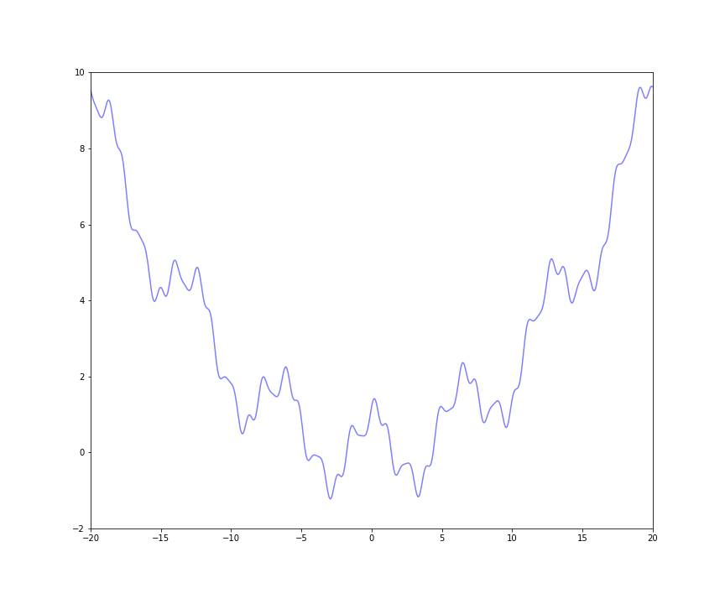
A 2-D example

Slide 11
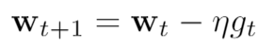
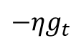
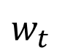
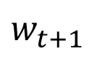
The vanilla SGD
$$w_{t+1}$$
$${−ηg}_{t}$$
$$w_{t}$$

Slide 12
Pros and cons of SGD
Simple, computational efficient, online learning
Hard to choose learning rate, hard to escape from saddle points

Slide 13
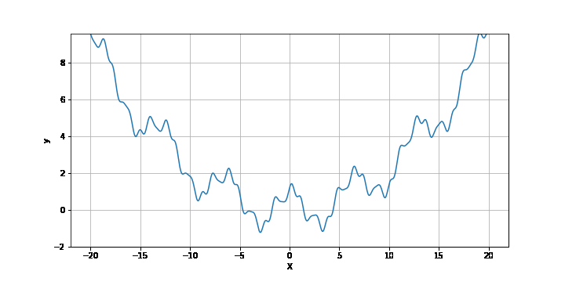
SGD on the example

Slide 14
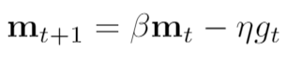
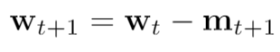
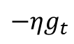
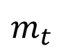
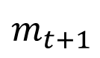
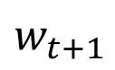
SGD with momentum (SGD-M)
$$m_{t}$$
$${−ηg}_{t}$$
$$w_{t+1}$$
$$w_{t}$$
$$m_{t+1}$$

Slide 15
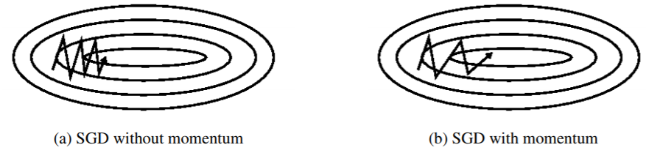
SGD-M improves SGD
Source: S. Ruder, 2016

Slide 16
SGD-M on the example

Slide 17
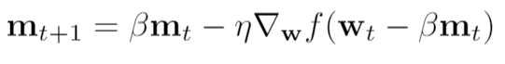
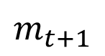
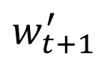
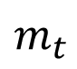
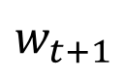
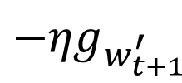
Nesterov accelerated gradient (NAG)
$$w_{t+1}^{′}$$
$${−ηg}_{w_{t+1}^{′}}$$
$$m_{t}$$
$$w_{t+1}$$
$$w_{t}$$
$$m_{t+1}$$
Notes:
This is like to foresee the gradient ahead, such that the update can be better anticipated.

Slide 18
Take home message of SGD-M and NAG
Help the training escape from local minima.
Faster convergence and reduced oscillations.

Slide 19
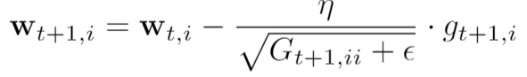
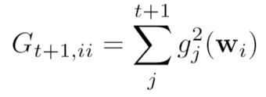
Adagrad (Adaptive learning rates)

Slide 20
Adagrad (Adaptive learning rates)
Works well for sparse dataset. For example, training the GloVe word embeddings.
The accumulative sum shrinks learning rate.

Slide 21
Adagrad on the example

Slide 22
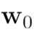
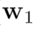
RMSprop
Slow
Fast

Slide 23
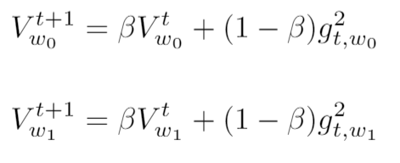
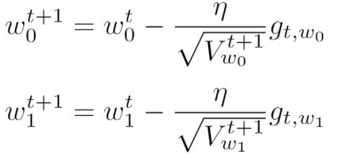
RMSprop
Slow
Fast

Slide 24
RMSprop on the example

Slide 25
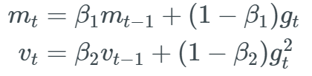
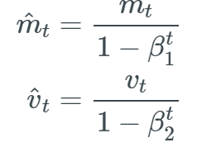
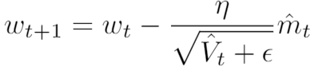
Adam – combination of SGD-M and RMSprop
Momentum
RMSprop

Slide 26
Adam on the example

Slide 27
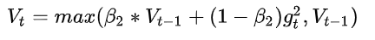
Problems of Adam
The exponential averaging limits the window size, it prevents vanishing learning rate, but could lead to divergence due to different properties of the windows.
Source: Reddi, et al, 2018

Slide 28
Problems of Adam
Adding the momentum to adaptive learning rate might make Adam miss the global minima.
The solution: First Adam then SGD
Source: Keskar, et al, 2017, Wilson, et al, 2018

Slide 29
A few final remarks
No single algorithm is superior to another.
Better to gain intuitions from datasets and cost function landscape.
Be open to different optimization in practice.

